Slide 1


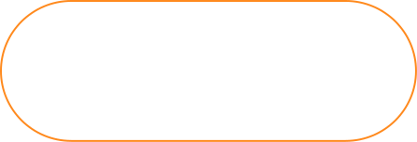
ShopCrawl
Shop with friends.
Make it fun.

Slide 2



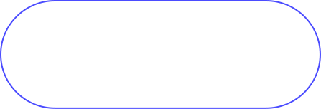
Meet the ShopCrawl Team
Anthony
Luke
Isaac

Slide 3

The Problem
Chore shopping is boring and monotonous
It’s hard for people to
meet new people
Time is valuable

Slide 4

The Solution
Make Shopping a Party!
ShopCrawl turns Shopping
into a Social Experience.
Join, Create, and Connect on Crawls.

Slide 5


Presentation Outline for ShopCrawl
Heuristic Evaluation Results
All major UI and Product Revisions
Prototype Implementation Status
Demo of Prototype so far

Slide 6
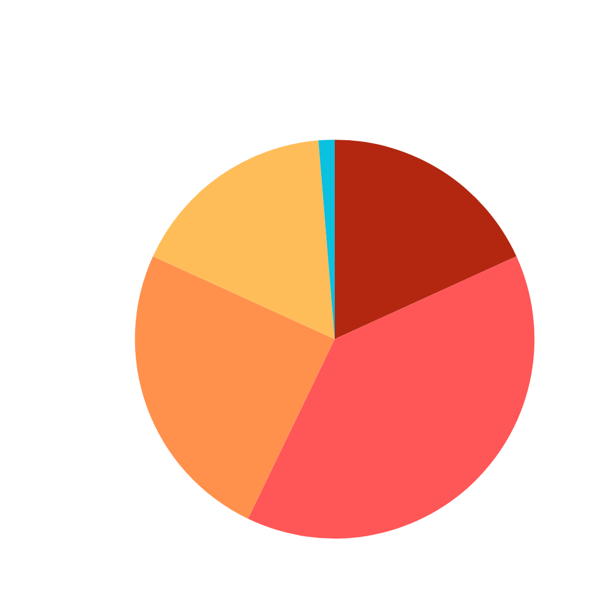
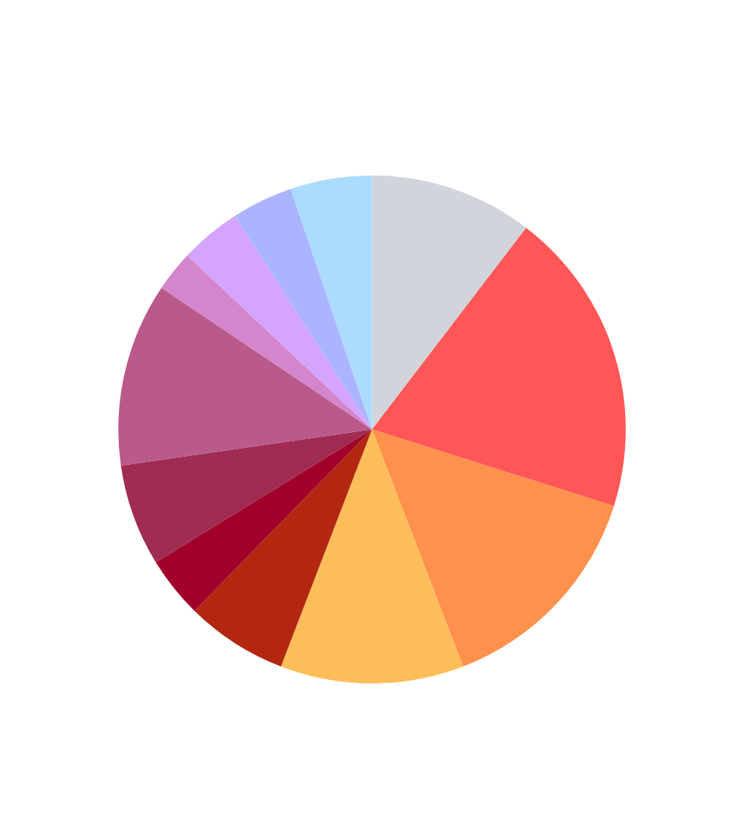
Heuristic Evaluation Results
Visibility of System Status
Match Between System & World
User Control & Freedom
Consistency & Standards

Slide 7
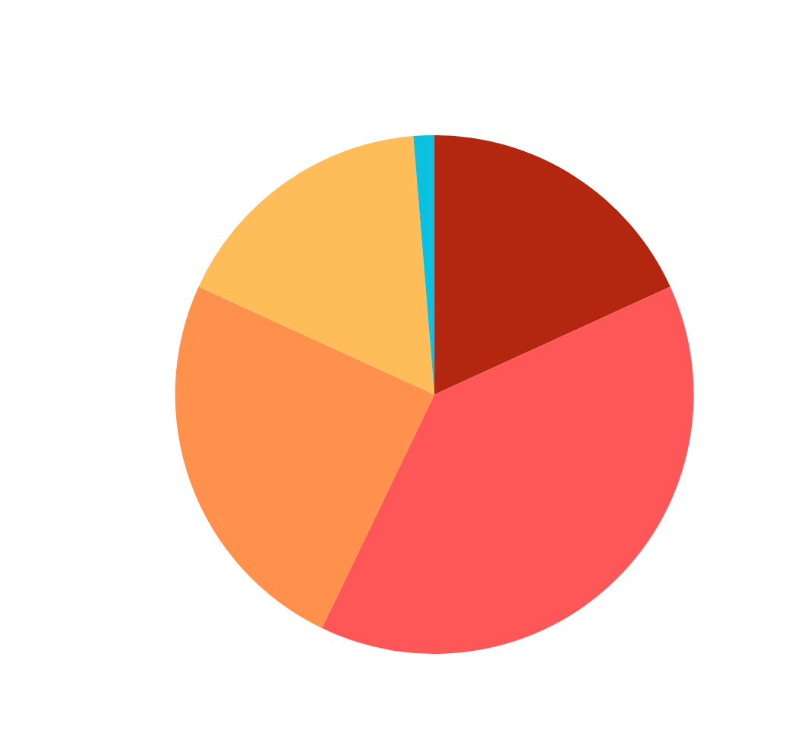
Heuristic Evaluation Results
Common Themes
  Use consistent and accessible design
  Add clarity of actions
  Enhance user control
Addressed 41 (Severity 3 or 4) violations, 3 (Severity 2) violations, and 2 (Severity 1) violations.
All major UI and Product Revisions

Slide 8
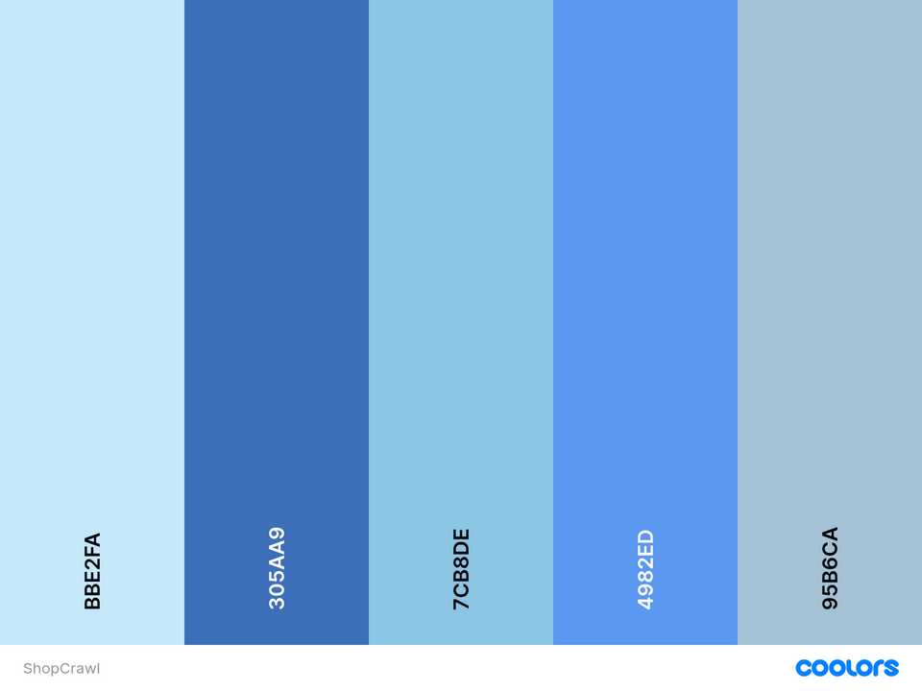
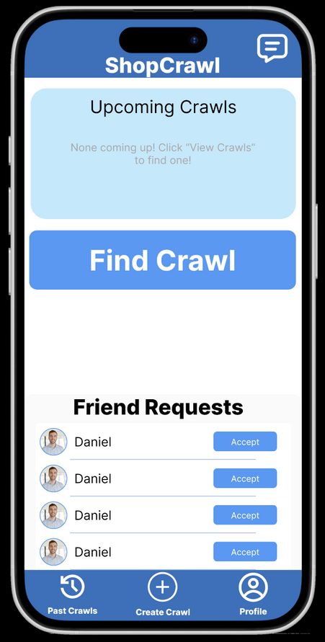
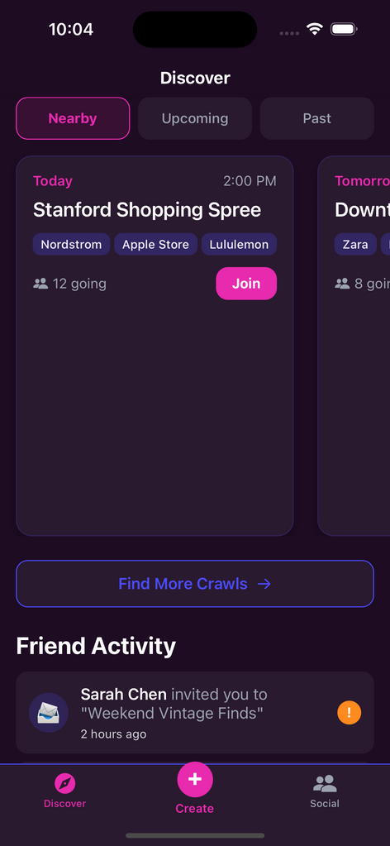

Use Consistent and Accessible Design
Violations 3, 22, 27, 43: Visual style
Notes:
Violation 3: Several text fields (e.g., “City,” “Length",” “Upcoming Crawls”) and buttons use small font sizes and low-contrast light blue backgrounds
Violation 22: The screen feels visually crowded, with large map pins, heavy blue crawl cards, and equal visual weight for all elements. The “Create Crawl” button blends with the crawl list instead of standing out.
Violation 27: The “Add Crawlers” screen cuts off part of the interface at the bottom and does not allow scrolling, so users can’t see all recommended crawlers or the full “Add Crawlers” button.
Violation 43: The app’s visual style (button sizes, text weights, icon alignment, and blue color tones) varies across screens.

Slide 9
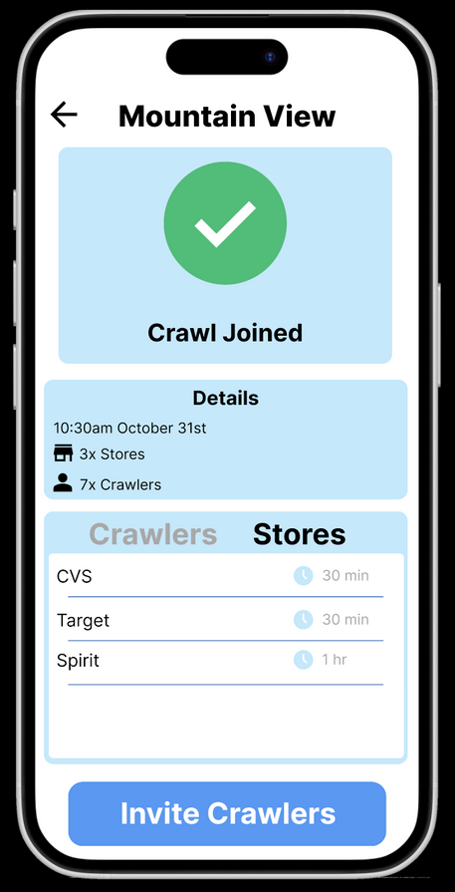
Use Consistent and Accessible Design
Violation 2: Unclear how to go back to home screen
Notes:
Violation 2: There is no way to go back to the home screen after joining a Crawl.
Violation 8: When you search for a person it shows up as a pop-up

Slide 10
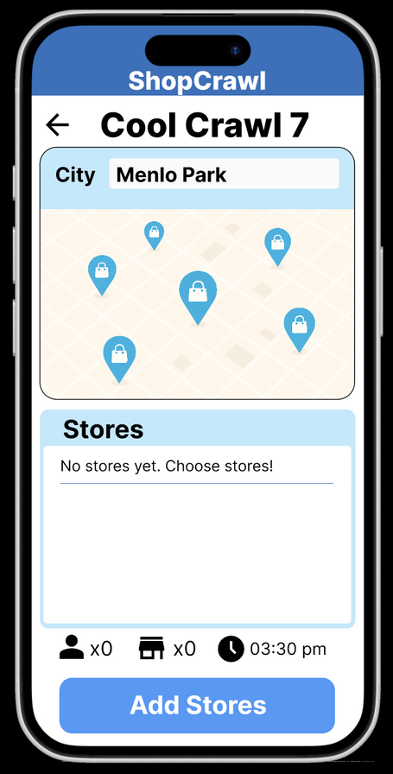
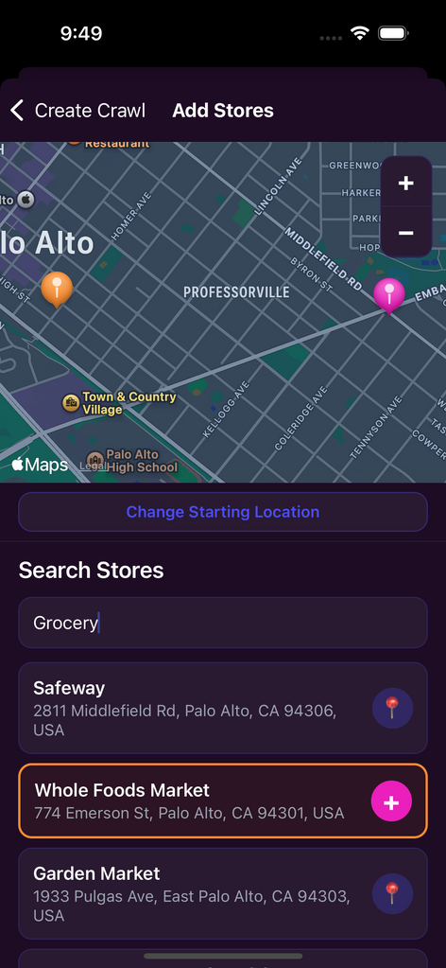
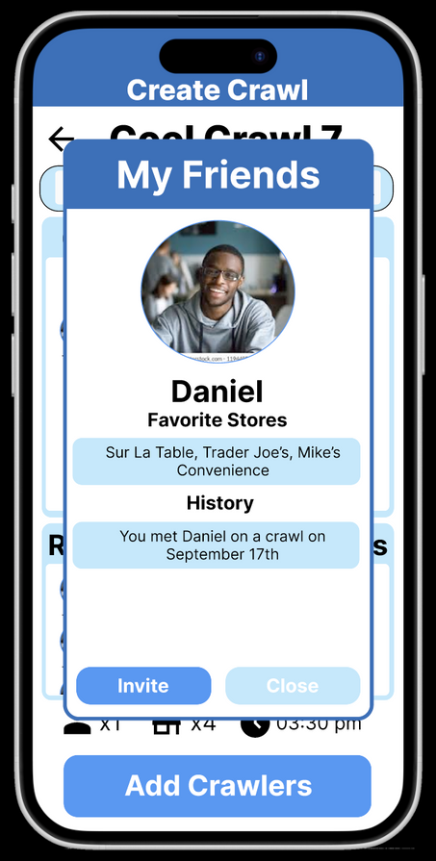
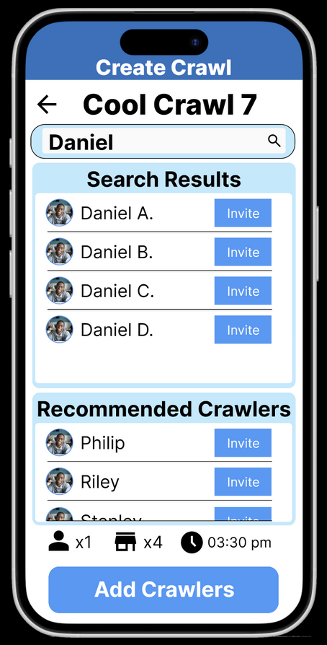
Use Consistent and Accessible Design
Violation 8: Cannot differentiate between friends with the same name
Violations 13, 34: No list view in shop search
Notes:
Violation 13: By relying on the map visual to communicate where stores are, it is not super accesible
Violation 34: The user has no way of searching for stores to add to their Crawl.
Violation 8: When you search for a person it shows up as a pop-up

Slide 11
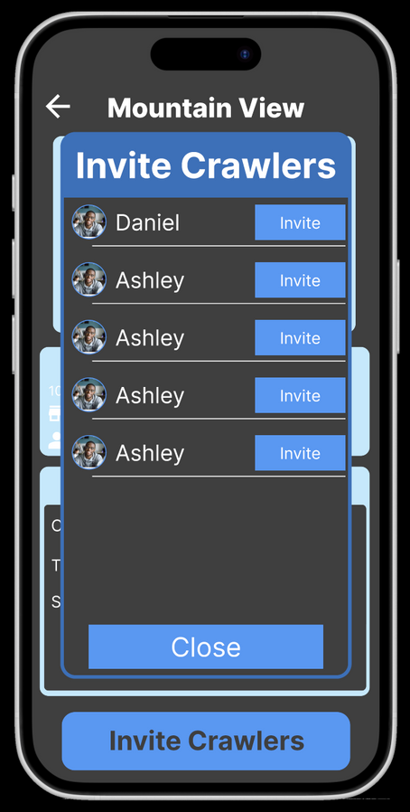
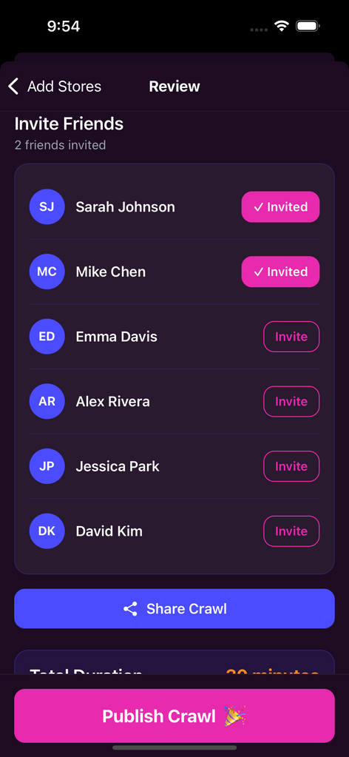
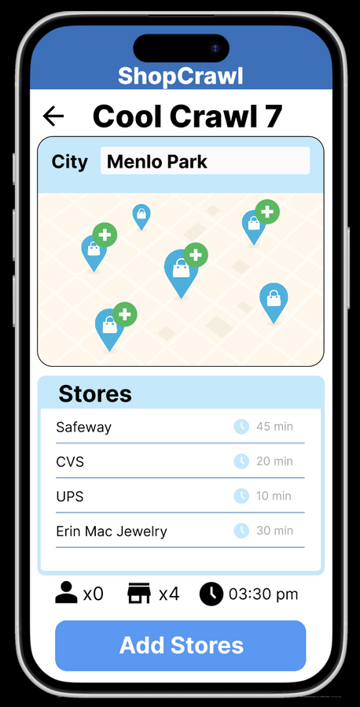
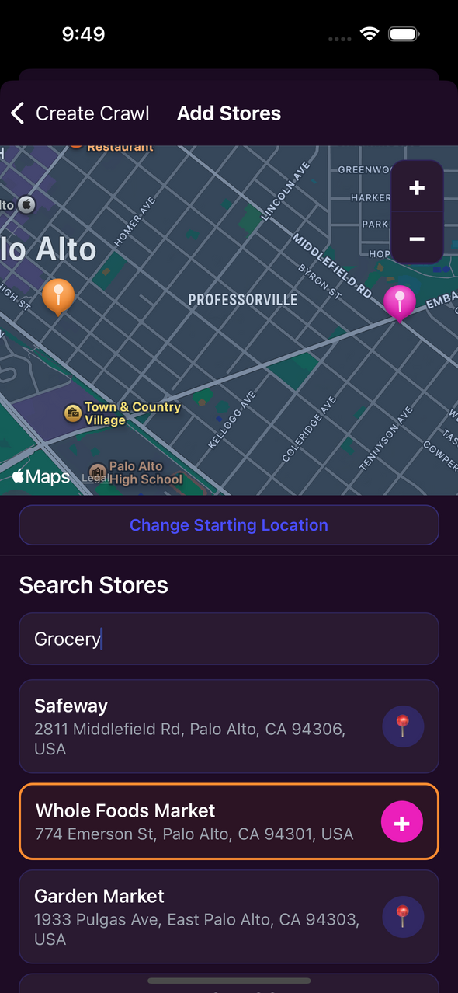
Add Clarity of Actions
Violation 15: No confirmation when friend is invited
Violation 12: No indicator of current task
Notes:
Violation 15: When pressing the “Invite” button on the “Invite Crawlers” screen, nothing changes to confirm that the invite was sent.
Violation 12: None of the screens show the task you are currently on.

Slide 12
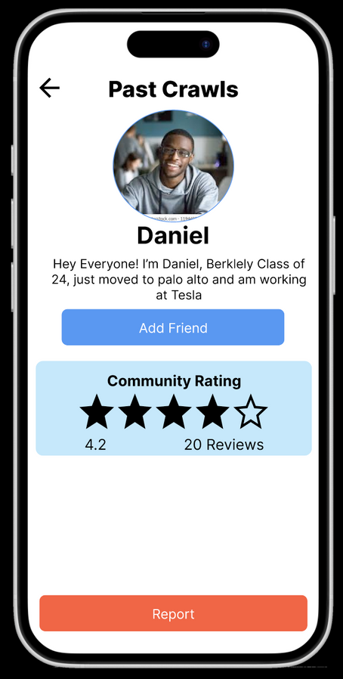
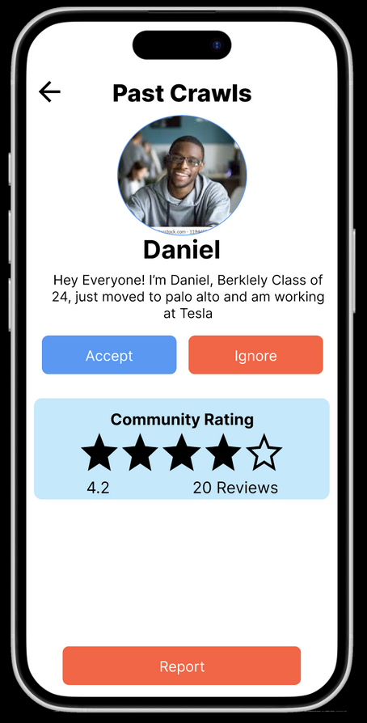
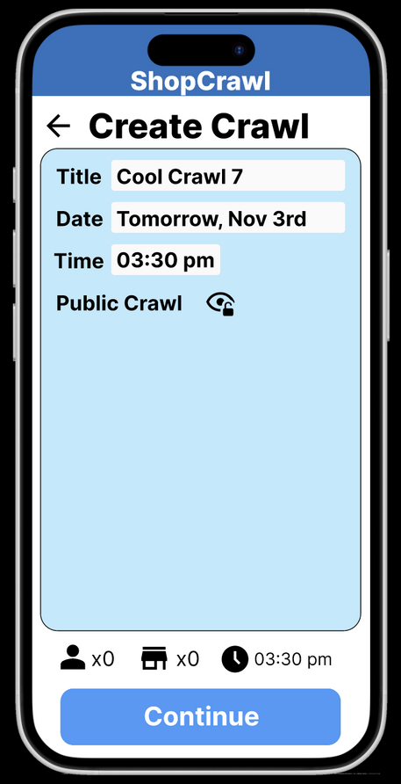
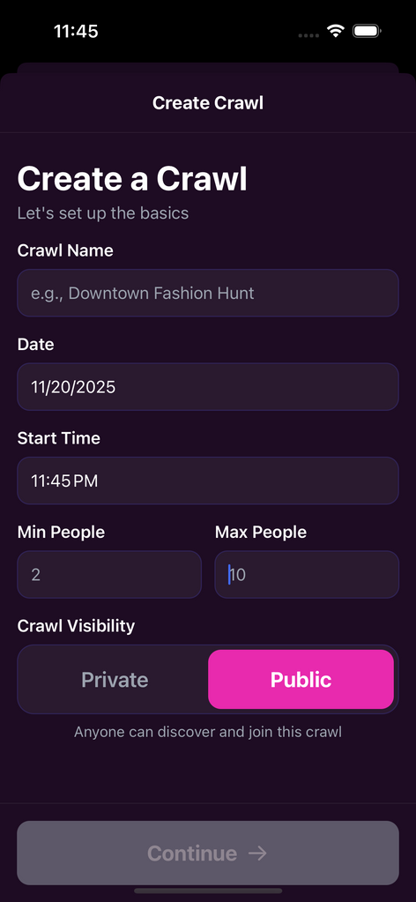
Enhance User Control
Violation 11: Cannot decline a friend request
Violation 42: Cannot set max people for Crawl
Notes:
Violation 11: No way to decline a friend request
Violation 42: There is no way to cap the number of people attending a Crawl.

Slide 13
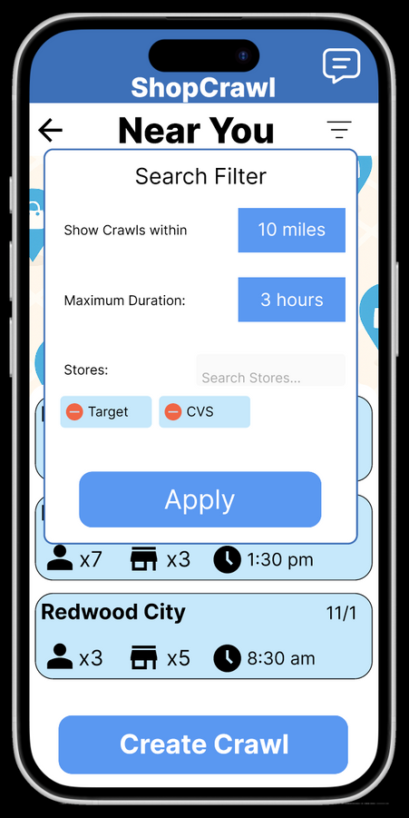
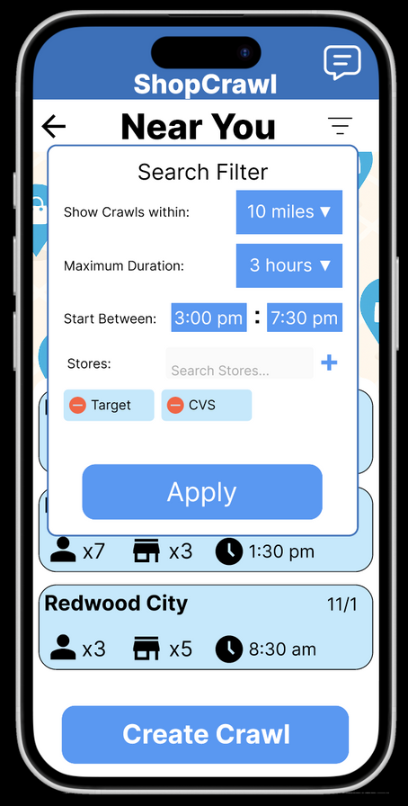
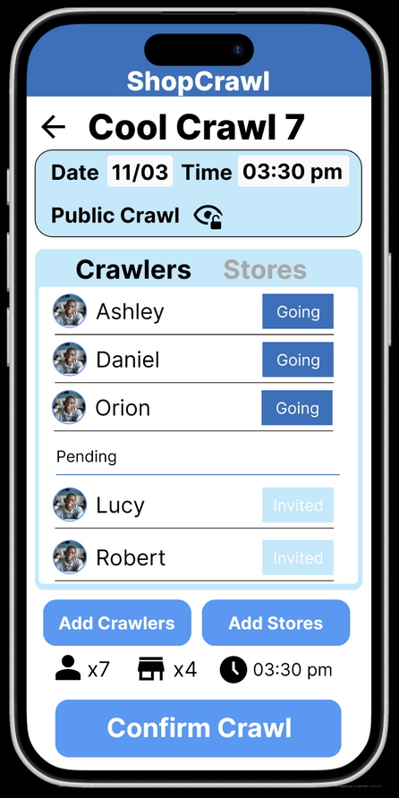
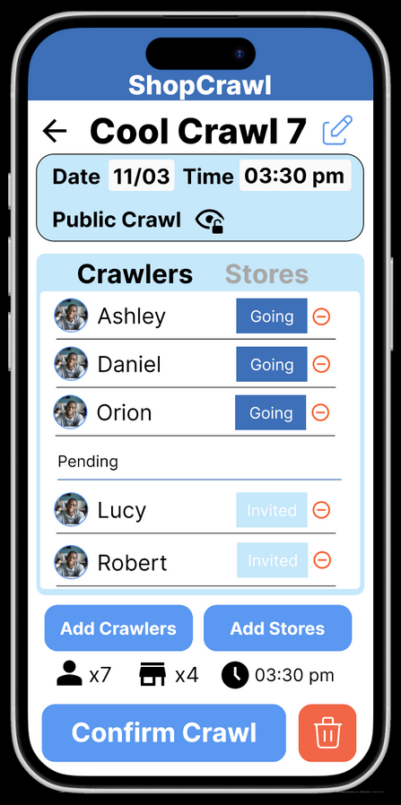
Enhance User Control
Violation 17, 23, 24: Lack of Crawl search filter options
Violation 5, 7, 29, 33, 35: Lack of options to edit your own crawl
Notes:
Violation 17: The Search Filter modal does not appear to have any way of adjusting the distance nor time of Crawls to filter by.
Violation 23: The search filter modal does not appear to have any way of adding new stores to the filter.
Vioaltion 24: There is no way to filter by start time.
Violation 5: The user has no way of seeing who has joined the Crawl they created.
Violation 7: There is no way to cancel a Crawl that the user has created.
Violation 29: There is no way for users to remove Crawlers from their Crawl that may make them feel unsafe.
Violation 33: There is no way for users to remove Crawlers from their Crawl that may make them feel unsafe.
Violation 35: There is no way to edit the details of a Crawl after creating it.

Slide 14
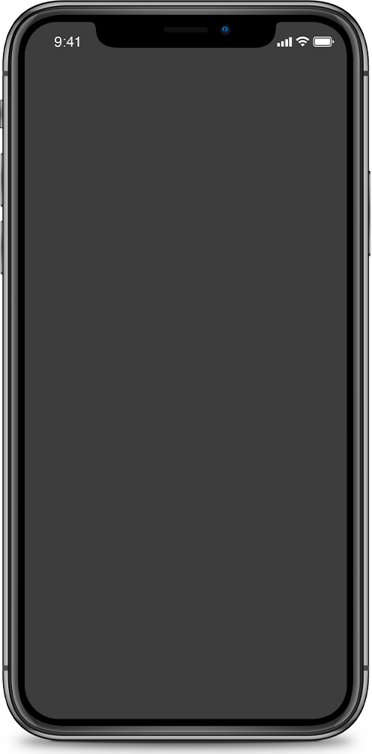
Insights from Severity 1 and 2 Violations
  Lots of white space: Use the real estate for functionality like multimodal shop search.
  Unclear that some buttons are clickable: Add visual indicators that buttons are actionable.
  Standardize text weight and style across the app, but use contrast for important actions.
Notes:
Violation 72: There is a lot of white space on the "Create Crawl" screen.
Violation 68: it's not clear to click a pin on the map
Violation 63: Some buttons use bold text while others use regular-weight text, creating inconsistent emphasis across screens.
Violation 53: The screens are densely packed with similarly weighted text and buttons, making it difficult to identify the most important actions.
Violation 52: Toggle isn't clear for public vs private crawl.

Slide 15
Progress towards each usability goal
Goal 1: Engagement and Eagerness
  Enhancing user control allows users to feel safe on ShopCrawl, and also gives them the freedom to customize their Crawls.
  Consistent and accessible design means a fun, beautiful app that users look forward to using.
Next Steps: Amplify the social experience with new features such as Crawl specific group chats.

Slide 16
Progress towards each usability goal
Goal 2: Efficiency and Ease of Use
  Increasing the clarity of all actions leads to fewer mistakes, less confusion, and increased efficiency.
  Accessible design allows ShopCrawl to cater to a wider audience, letting users choose how to use our app.
Next Steps: Ensure we keep a consistent design language throughout development for learnability.
Prototype Implementation Status

Slide 17





Prototype Implementation Status
Framework/Tools
AI Use
Wizard of Oz
Hard-coded
React Native through Expo for Mobile Development
Supabase for Database
Figma for Design
Github for Collaboration
Used Figma Make to test different color palettes for our design language. Why: allowed us to efficiently test multiple design languages.
Used Cursor to set up backend logic for Google Maps API server. Why: Cursor set up a local server for custom routing to enhance the map experience.
Friends you invite to any Crawls will automatically accept your invitation, since they are not real people.
Messaging a friend is simulated, since they are not real people.
Currently all other “Crawlers” and public “Crawls” are hard-coded as we do not have a functional social network.
Any completed Crawls will be hard-coded as we do not expect testers to complete Crawls alone with fake friends.

Slide 18
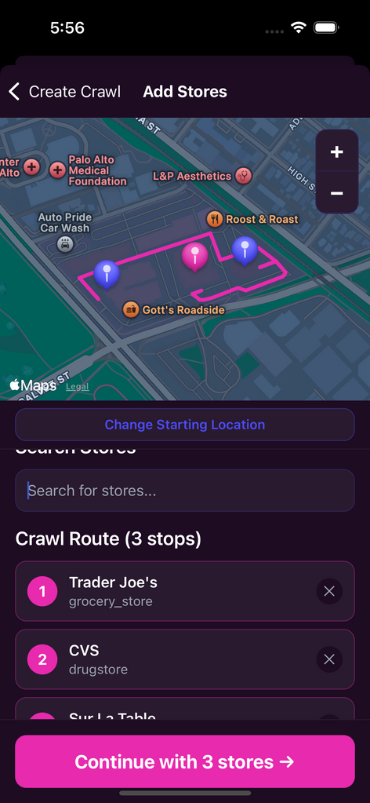
Prototype Implementation Status
Implemented Features
Moderate task: Create Crawl
Home page, Navigation Tab Bar
Integration with Google Maps API
Custom routing of Crawl
Supabase storage of Crawl details and locations

Slide 19
Prototype Implementation Status
Unimplemented Features
Implement during Thanksgiving Break:
  Simple Task: Join a Crawl
    Populate Supabase with Upcoming Crawls
    Create area to manage your joined upcoming Crawls
  Complex Task: Connect with people from Past Crawls
    Populate Supabase with Past Crawls
    Create friend management area
Implement during Week 10:
  Messaging interface with friends and Crawl specific group chats.
  User safety functionality (Block, Report, User Ratings)
  Question: Figure out how to set up nonlocal custom Maps routing so running from an Expo QR code will work.
Plan for finishing: Thanksgiving Break schedule will be informal; members pitch in whenever and wherever they can / want.
We will schedule several in person code session for week 10. Anthony and Isaac will prioritize the backend while Luke takes lead on the frontend.

Slide 20
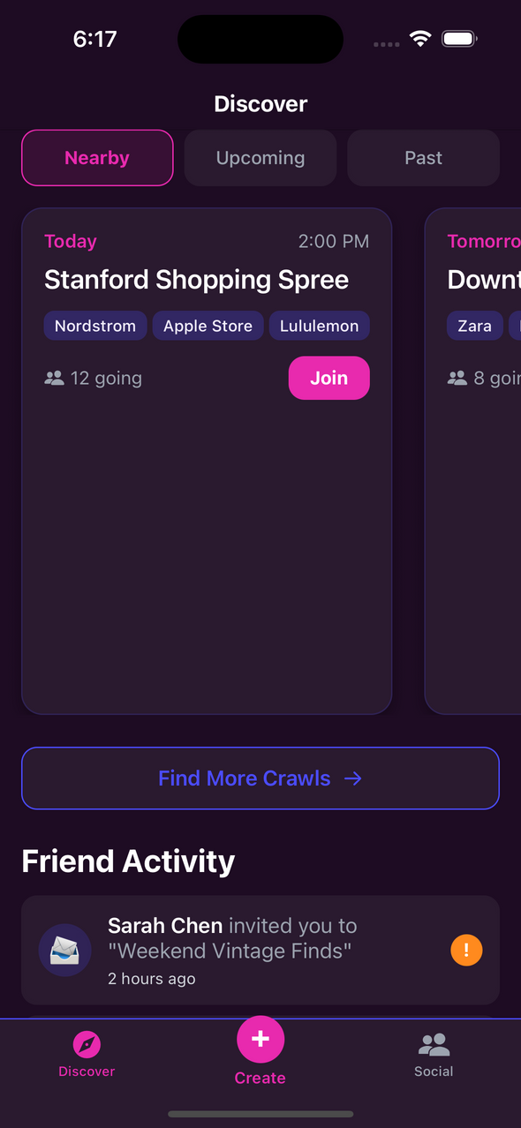
Demo

Slide 21
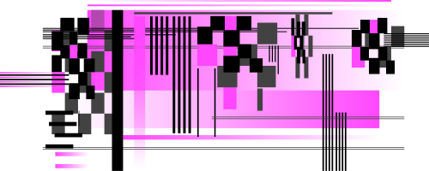
Appendix
ShopCrawl A8

Slide 22
Other Severity 3 and 4 Violations
Violations 1, 4, 6, 9, 14, and 38 relate to issues from reusing screens in the Figma wireframing.
We follow the reviewers’ advice to ensure the high-fi will correctly handle these tasks.
Violations 10 and 25 relate to a lack of confirmation from actions, which could potentially cause errors. We address these issues with proper confirmation or error messages, similar to our solution for Violation 15 (Slide 11).
Violations 18 and 30 relate to the use of a placeholder map image instead of an actual map. This issue is resolved with the use of a map API to see real-time maps and store locations.
Violations 39 and 40 relate to the in-app messaging layout. We design our chat layout with popular messaging platforms in mind to ensure ease of use for users.
Notes:
Violation 1: When going to find another Crawl to join then backing out to the home screen, the previously joined Crawl is gone.
Violation 4: The location of the Crawl I created was set to Menlo Park. However, in the home screen, it says that the Crawl is in Redwood City.
Violation 6: When going to create another Crawl then backing out to the home screen, the previously created Crawl is gone.
Violation 9: Clicking on the past Crawl in Redwood City takes the user to the past Crawl for Palo Alto.
Violation 14: Clicking on any friend request from Daniel pulls up info from a different Daniel, as evidenced by the different profile pictures.
Violation 38: Clicking on Ashley's profile in a past crawl takes the user to Daniel's profile.
Violation 10: Pressing the "Add Friend" button does not do anything.
Violation 25: If a user enters an invalid filter (for example, leaving distance blank) and presses “Apply,” there’s no visible error or guidance.
Violation 18: The map on the "Near You" screen shows an image of a map of a generic street layout, rather than showiong a real map.
Violation 30: The map on the "Cool Crawl 7" screen is a generic placeholder image of a street layout.
Violation 39: The chat layout is inconsistent with familiar messaging conventions. Messages appear in the same color and alignment for both users, so it’s unclear who sent which message.
Violation 40: It is unclear how to send a message in the Messages screen.

Slide 23
Other Severity 3 and 4 Violations
Violations 19 and 32 relate to ambiguity in the crawl duration variable. We will make sure the crawl duration is clear for both the time spent at each store and in total.
Violation 26: Buttons we request the user to press are named verbatim, to not confuse the user.
Violation 31: The “close” button is changed to a “cancel” button as per the suggestion.
Violation 79: We will automatically start an in-app group chat for the Crawl when a Crawl is created, and add users to the group chat when they join a Crawl, as per the suggestion.
Violation 36: A warning will appear if you try to add a store that will be closed during your Crawl time.
Violation 37: Will use empathetic language, e.g. “We’re here to help keep the community safe.”
Notes:
Violation 19: The cards for the individual Crawls do not show how long the Crawls are.
Violation 32: There is no way to specify Crawl duration.
Violation 26: When empty, Upcoming Crawls section says to click "View Crawls" to find a Crawl. However, there is no "View Crawls" button.
Violation 31: Button says "close" after you enter the amount of time you want to crawl for. and "add store."
Violation 79: Once you join a crawl there is a lack of next steps or communication to make sure the crawl actually happens
Violation 36: There is no feedback to let users know that a certain store is closed during their specified time when creating a Crawl.
Violation 37: The reporting flow lacks contextual reassurance, such as empathy-driven language or links to community safety resources.

Slide 24
Other Severity 3 and 4 Violations
Violation 20: Added a button to leave a joined Crawl.
Violation 21: Route view shows the order of stores you go to.
Notes:
Violation 20: There is no way to cancel or back out of a Crawl after joining.
Violation 21: In the screen where you are viewing the details of a crawl you want to join, it's unclear which store you start at.

Slide 25
Severity 3 and 4 Violations
Not Addressed
Violation 16: Users cannot see all participants of a crawl by design, to preserve the privacy of Crawlers who are not in their friends list. We choose not to implement the proposed solution of showing all identities; however, we will pay extra attention to implementing other safety features to mitigate potential dangers.
Violation 28: We decided not to add a progress bar/step counter because there are only 3 short steps, and we believe it would add clutter to the design.
Violation 41: Feedback from our testing reveals that our task flows are easy to navigate. We will revisit adding onboarding for the task flows if we receive further feedback that our task flows are confusing.
Notes:
Violation 16: Cannot see some users in a crawl.
Violation 28: There is no progress indicator/header for your progress in creating a crawl
Violation 41: There is no onboarding for the task flows.

